Slide 1

Net.Art Process Book
By Brandy white

Slide 2
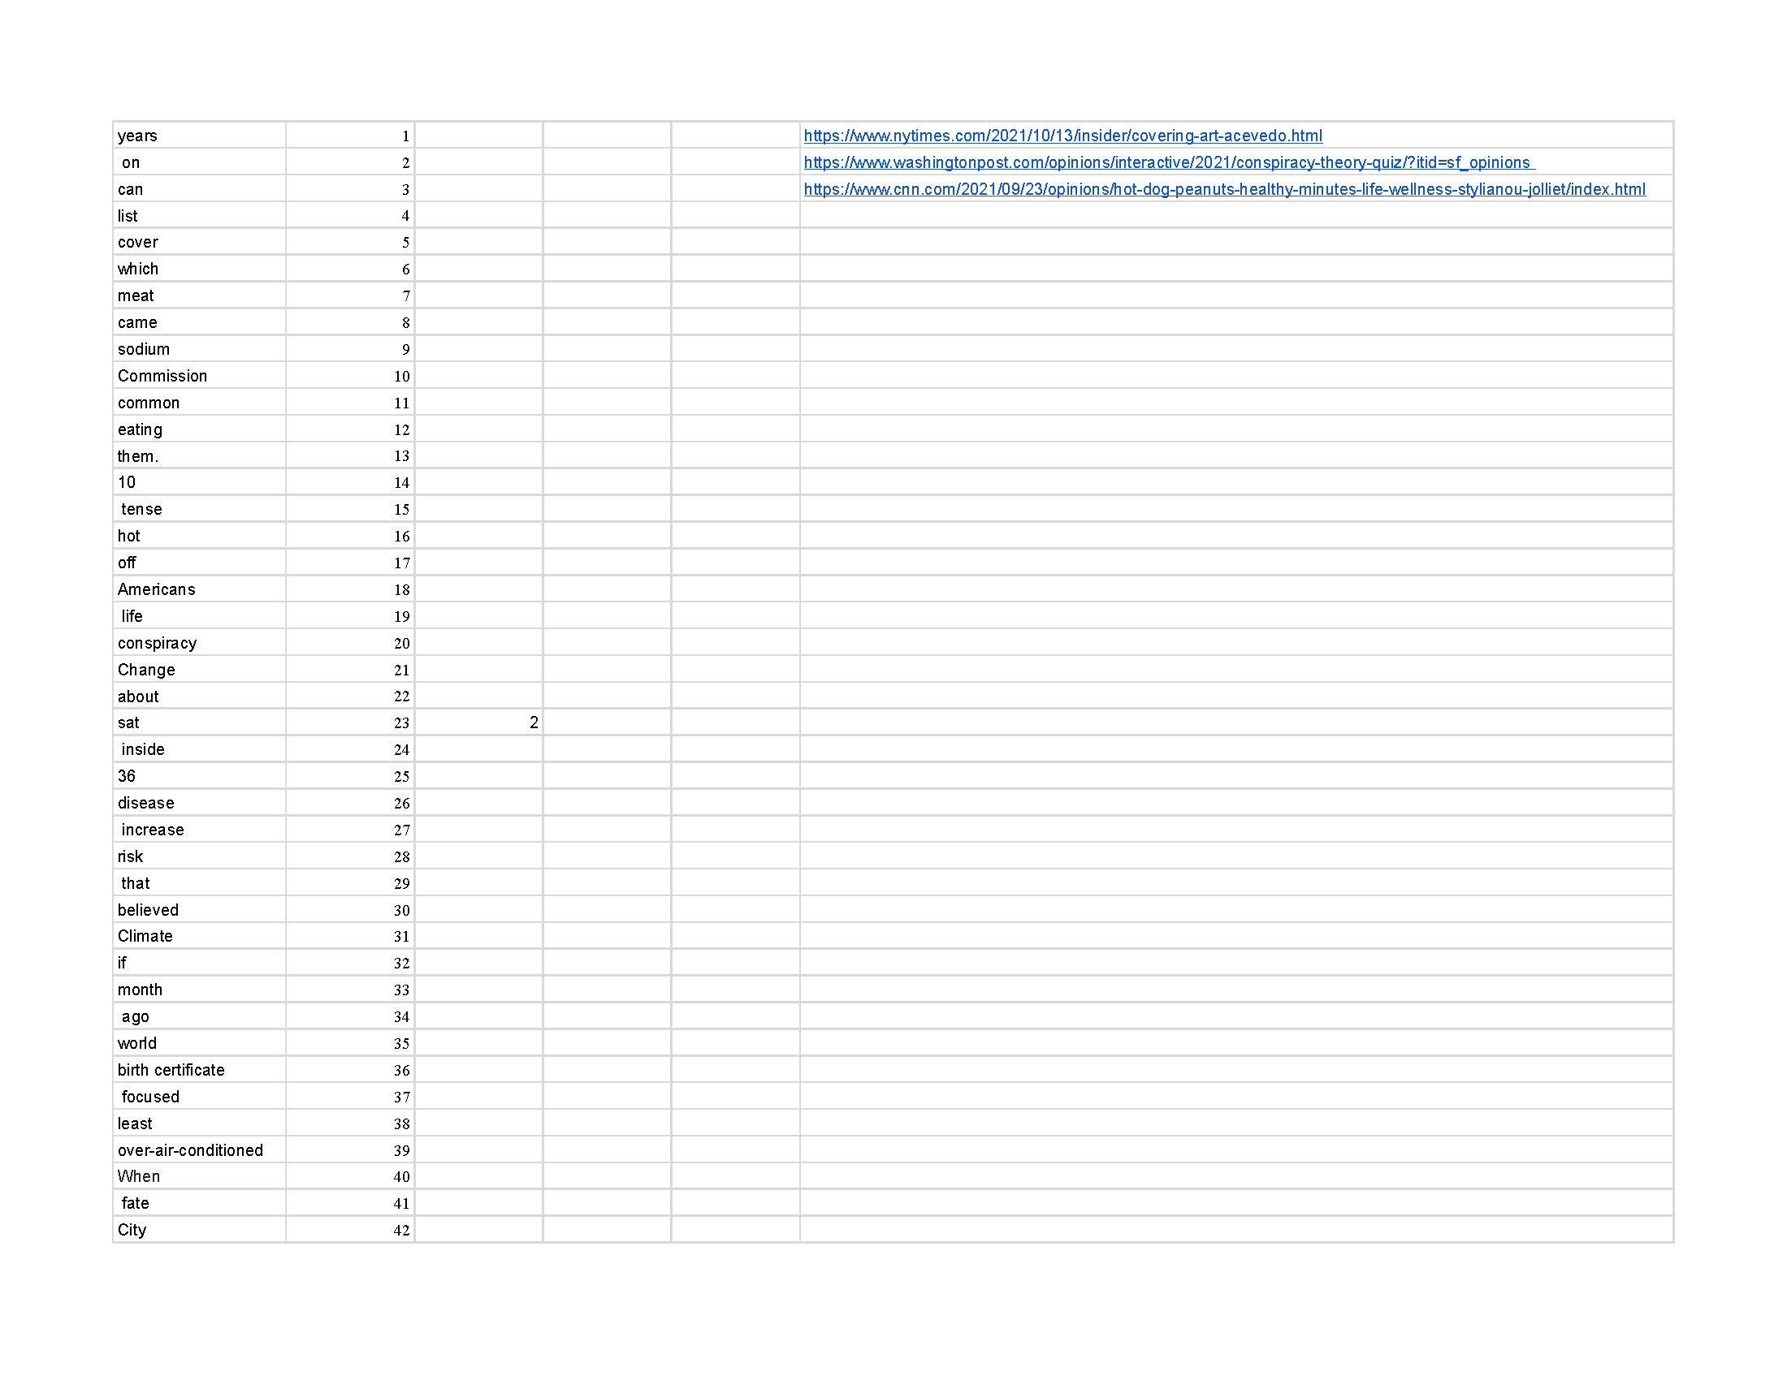


Word Game
These are the Words that I placed into the Excel Sheet and used Random.org to create the Word list for my Net.Art Painting

Slide 3
News Articles
- CNN
https://www.cnn.com/2021/09/23/opinions/hot-dog-peanuts-healthy-minutes-life-wellness-stylianou-jolliet/index.html
- https://www.washingtonpost.com/opinions/interactive/2021/conspiracy-theory-quiz/?itid=sf_opinions
- https://www.nytimes.com/2021/10/13/insider/covering-art-acevedo.html

Slide 4
Sentence to Work with
- 10 Tense hot off Americans life conspiracy change.

Slide 5
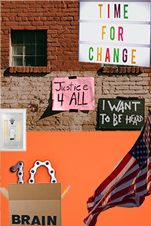
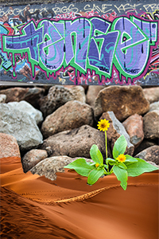
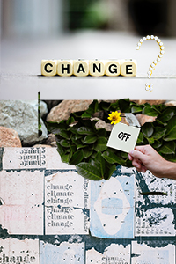
Collage

Slide 6
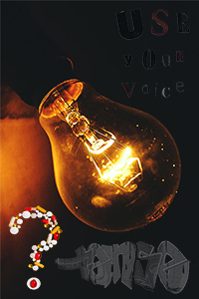
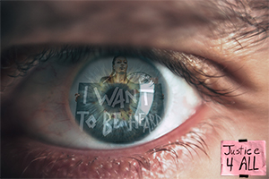
Collage

Slide 7
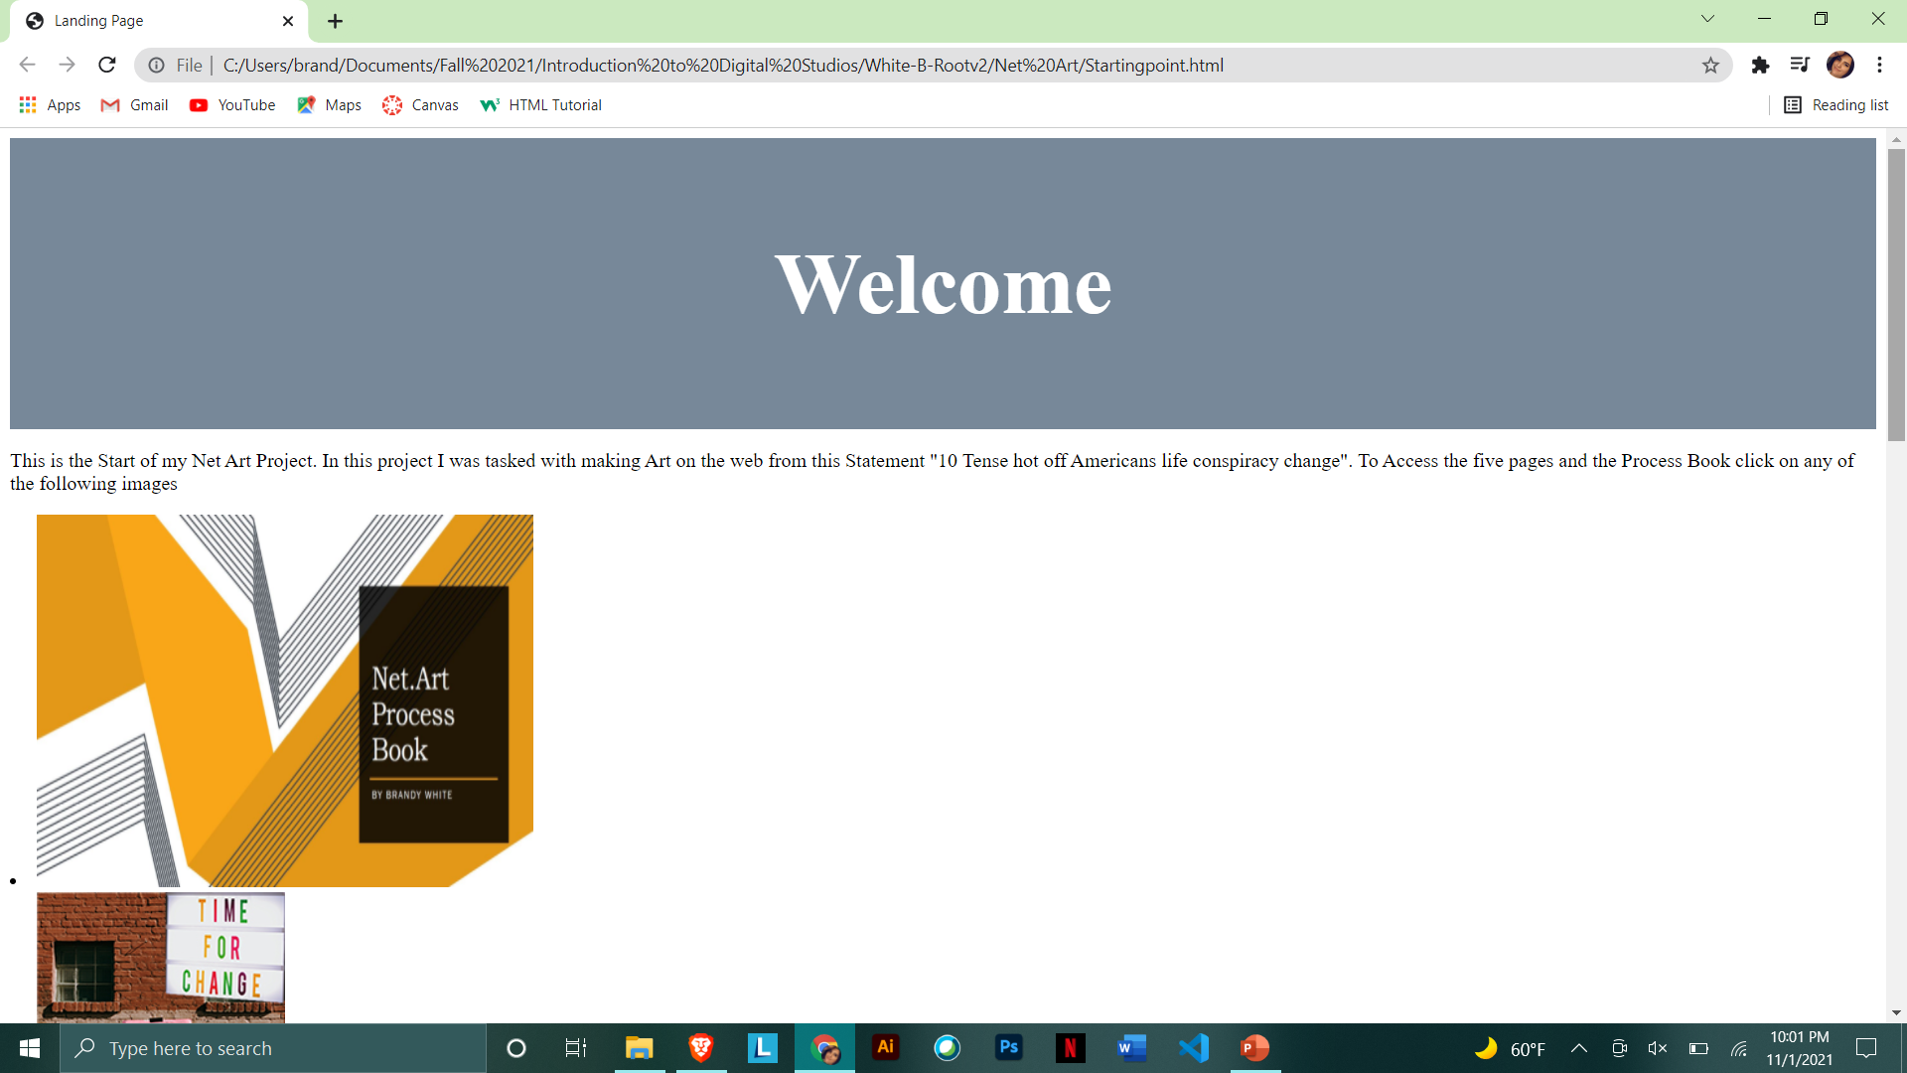
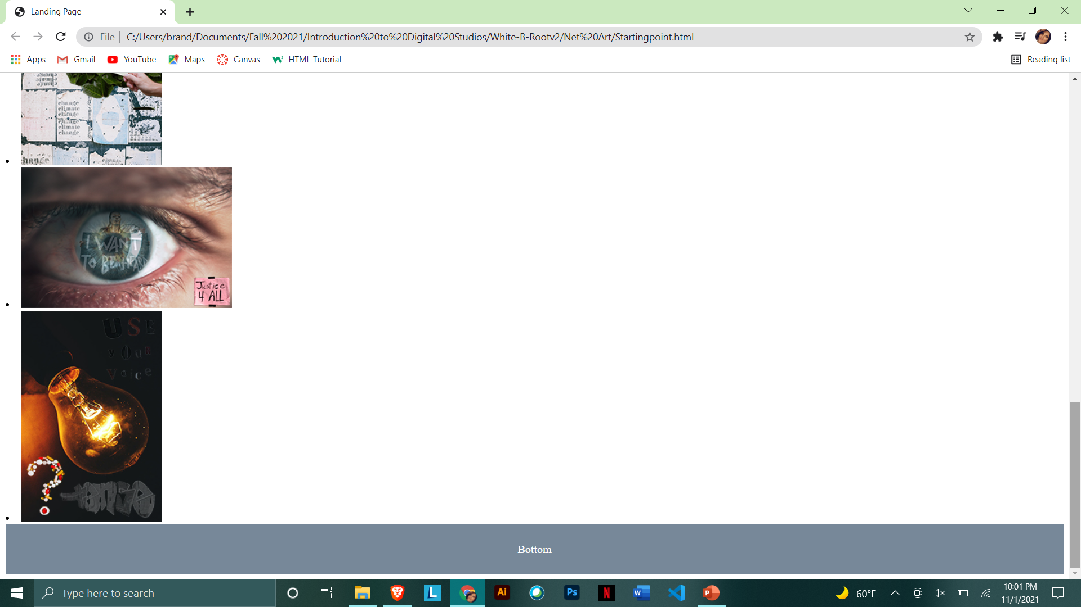
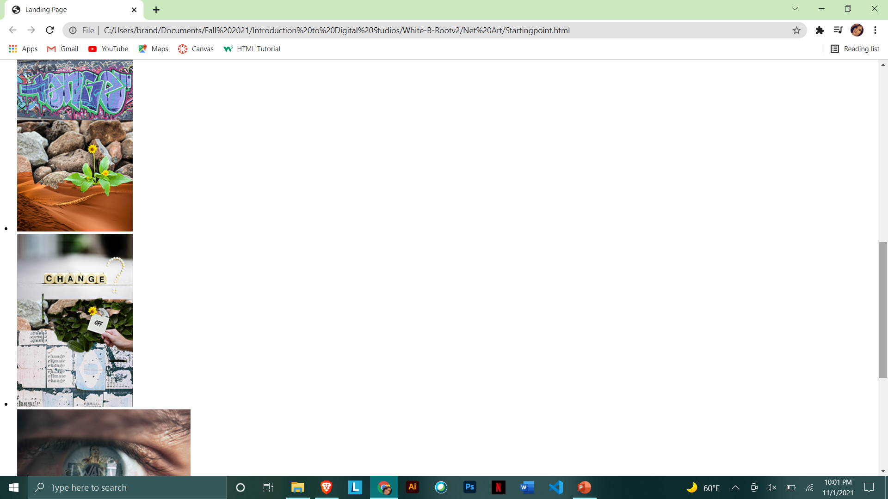
Landing Page

Slide 8
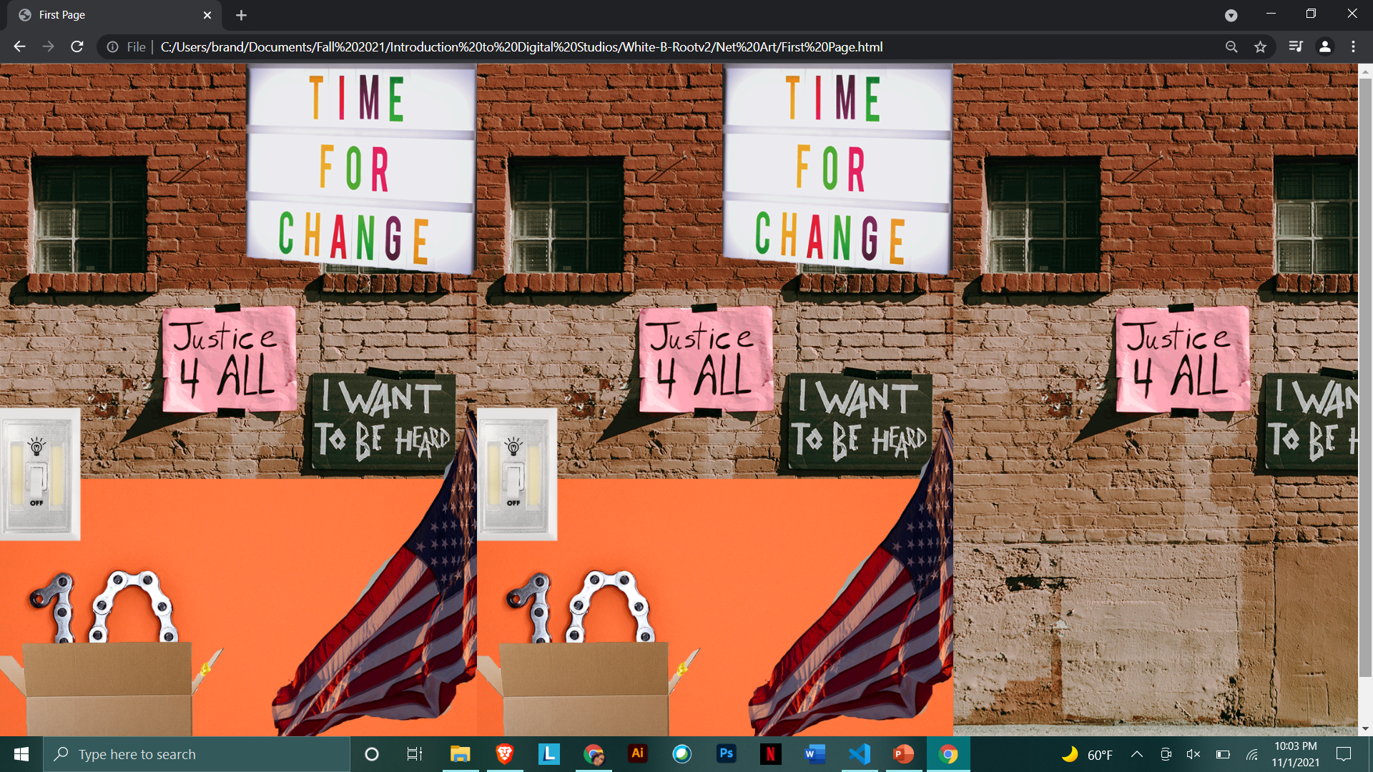
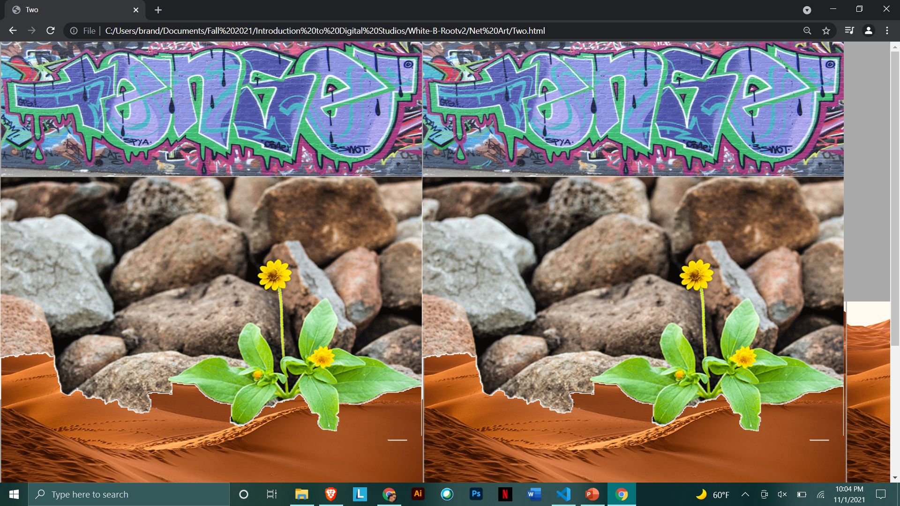
Web Pages
These Are the first two pages in the Art piece and have hidden links to the different pages
In each, linking them all together in different ways.

Slide 9
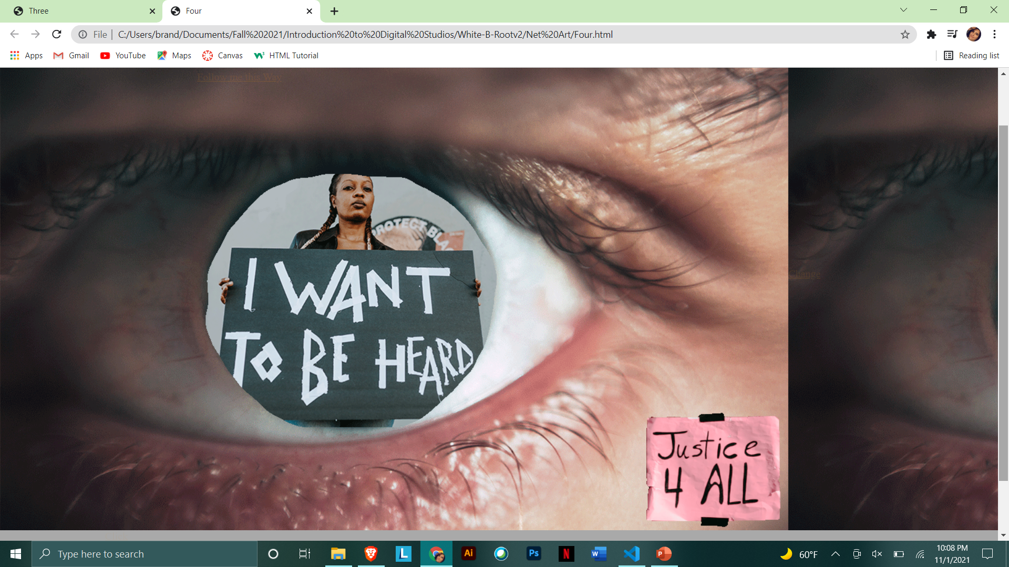
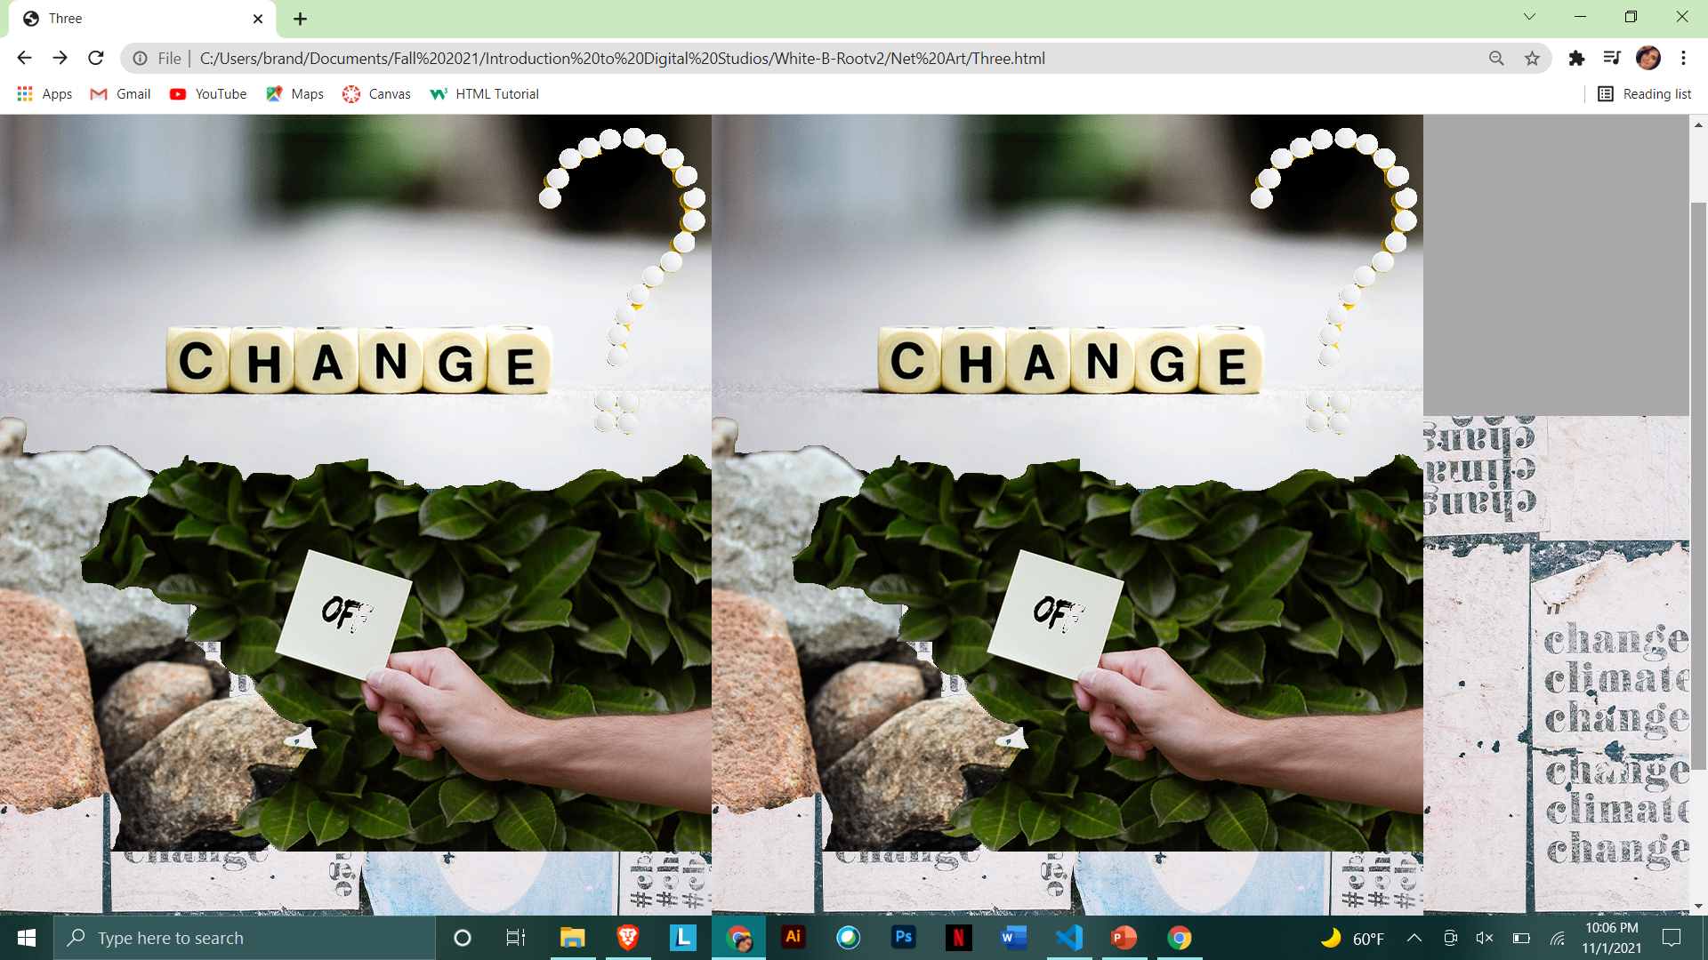
Web Pages
These are Pages Three and Four

Slide 10
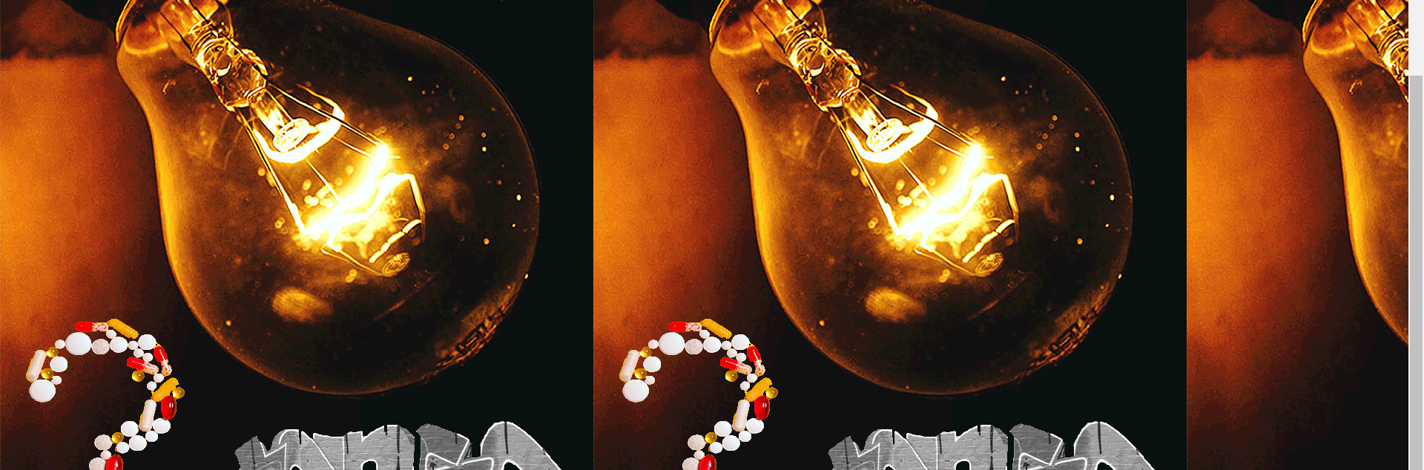
Web Pages
This is the final page in this series, page five

Slide 11
Artist Statement
This Project Was very challenging for me as I am not well versed in Html and have some trouble. A problem that I ran into rather quickly was getting the transparent images to align and resemble the vision that I had in my head as to what I wanted them to look like. I went with a almost transparent look for my web pages because I ran into trouble with buttons, and I liked the scavenger hunt look for the links to each part and how they all connected differently. I had a great time figuring out the different challenges I had to overcome and hope for another chance to explore more concepts like this.

Slide 12
Image Sources
10 - Photo by Miguel Á. Padriñán from Pexels
Waving flag - Photo by Sawyer Sutton from Pexels
Statue of Liberty - Photo by Pixabay from Pexels
Tense - "TENSE" by JOHN19701970 is marked with CC0 1.0
Lightbulb - Photo by ARUNODHAI VINOD from Pexels
Desert - Photo by Pixabay from Pexels
Off Switch - Photo by Tara Winstead from Pexels
Off - Photo by Oleg Magni from Pexels
Life - Photo by Nacho Juárez from Pexels
Life of Now - Photo by Elina Fairytale from Pexels
Justice - Photo by RODNAE Productions from Pexels
Want to be heard - Photo by RODNAE Productions from Pexels
Time for Change - Photo by Alexas Fotos from Pexels
Climate Change - Photo by Alexas Fotos from Pexels
Change - Photo by Nothing Ahead from Pexels
Use - Photo by Polina Kovaleva from Pexels
Brain - Photo by SHVETS production from Pexels
Eye - Photo by Victor Freitas from Pexels
Question Mark - Photo by Anna Shvets from Pexels
Pill Questions - Photo by Anna Shvets from Pexels

